Slide 1
Minimum Level of Service
Prepared for: | Georgetown Planning Board
Date: | August 25, 2021
Version: | 1.0
By: | Steve Sadler 7 Hillside Drive

Slide 2
Georgetown Site Plan Review ByLaw §165-83

Slide 3
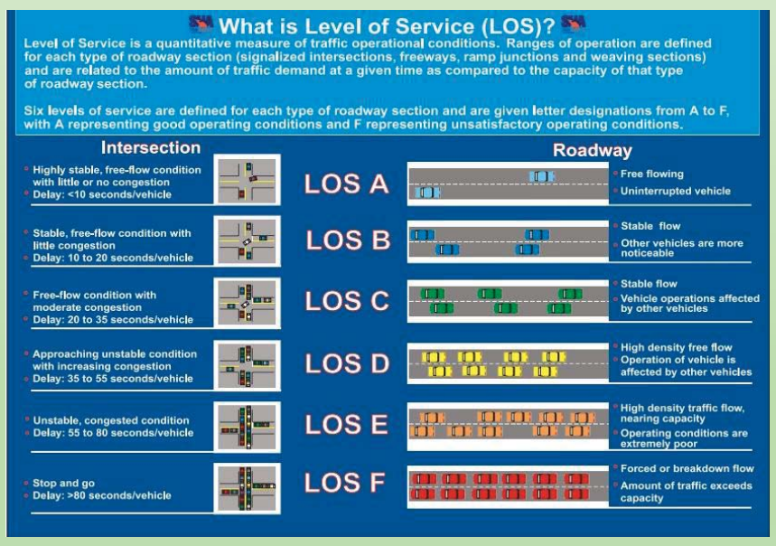
What is Level of Service?
Source: https://www.ite.org/pub/?id=B1E42E3D-CABC-003D-5C3F-6CCFFD0A7EC9

Slide 4
Ron Müller & Associates Traffic Review, G. Mello Transfer Station
Georgetown, MA – April 12th, 2021 – original study

Slide 5
Ron Müller & Associates Traffic Review, G. Mello Transfer Station
Georgetown, MA – April 12th, 2021 – updated Study
Capacity and Queue Updates
20. Revised capacity and queue analyses were performed at the study area intersections to
measure the actual traffic impact of the proposed transfer station based on the updated trip
generation estimates. Traffic exiting Carleton Drive will continue to operate at LOS F under
future Build conditions during the weekday AM and PM peak hours. During the Saturday
midday peak hour this movement is now expected to operate a LOS D. Turns from East
Main Street will still operate at an acceptable LOS A under future conditions during all peak
hours.
21. The I-95 interchange with East Main Street was also evaluated under the revised trip
generation and distribution estimates. Both the I-95 northbound and southbound off-ramps
are expected to operate the same as was shown in the original study.
Truck Turning Movements
22. Based on comments received at the Zoning Board meeting held on April 2, 2019, truck turning movements were evaluated at the skewed intersection of Carleton Drive and East Main Street. Turning movement diagrams were prepared by GPI showing the right turn movement from East Main Street to Carleton Drive and the left turn movement from Carleton Drive to East Main Street. Figures T1-T3 depict turning movement paths of WB-65 and single unit trucks entering and exiting Carleton Drive. Figure T-1 shows that a WB-65 truck will encroach upon the exiting lane on Carleton Drive when making a right turn from East Main Street. Based on MassDOT’s intersection design guidelines, this is acceptable. When turning from an arterial roadway to a local roadway a truck must stay on its side of the arterial however they may encroach onto the opposing direction of travel on the local street. It should further be noted that the larger WB-65 trucks represent the transfer trailers and only 20 of these types of vehicles are expected on a weekday, specifically on a peak operating day.

Slide 6
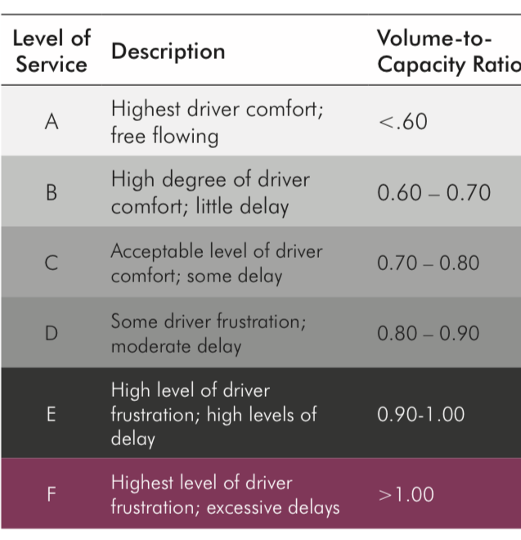
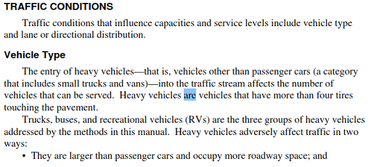
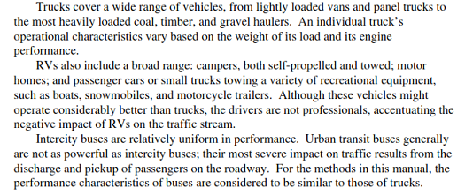
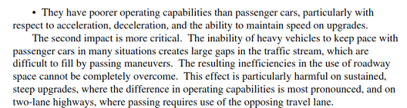
Is Level of Service D even possible?
Can we rely on Vehicle capacity Ratio?
··
Source: Highway Capacity Manual
For conceptual planning, V/C ratios are not adequate measures of quality of service,
and other supplemental methods, such as intersection delay, can be used for vehicle LOS. Intersection delay measures the time spent waiting in a signalized intersection. Source: https://www.trpc.org/DocumentCenter/View/2798/
Appendix-O--Level-of-Service-Standard-and-Measurement?bidId=
Did we factor traffic conditions by vehicle type?
Source: https://www.trpc.org/DocumentCenter/View/2798/
Appendix-O--Level-of-Service-Standard-and-Measurement?bidId=
Source: Highway Capacity Manual

